Slide 1
What Climate Science Knows About Big Data
Seth McGinnis
SEA Conference 2016
2016-04-04

Slide 2
Roadmap
What Big Data Is
The Big V’s
Volume
Variety
Velocity
…
Big Data in Climate Science
Dealing with Volume
Dealing with Variety
Data Services

Slide 3

What is Big Data?
Any dataset that’s “too much” to handle using traditional tools and techniques
Contextual and relative, not absolute
Enabled by exponential growth of computational capability
Also gets used to refer to specialized systems used to handle Big Data (machine learning, hadoop, etc.)

Slide 4
The 3 Big V’s (+ 1) (+ N more)
Originate in business & tech sector
Beware assumptions!
Big 3 (Laney 2001)
Volume
Velocity
Variety
Plus 1
Value
Plus many more
Veracity
Validity
Variability
Viscosity & Volatility
Viability, Venue, Vocabulary, Vagueness, …

Slide 5
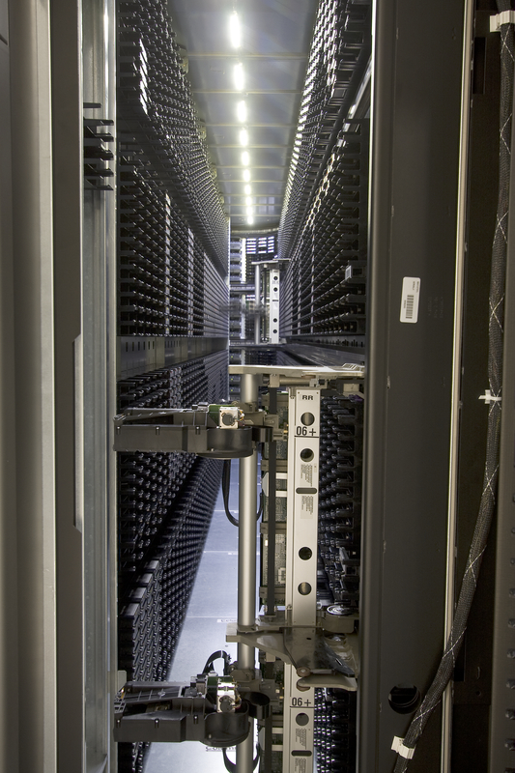
Volume
How much storage space the data takes up
Driven by exponential growth in storage capacity
Mediated by technology
Parallel processing
Better hardware

Slide 6

Velocity
How quickly data must be processed
Speed of storage / retrieval / analysis
Aspects:
Real-time (acted on immediately)
Timeliness (rate of capture/usage)
Lifespan (how long it’s valuable)
Response time
Strategies:
simple ingest & access
parallelization
better hardware
“Proper velocity”: tied to real-world demand
“Apparent velocity”: trade-off for volume

Slide 7

Variety
How heterogeneous the data is; complexity
Many features per item
Irregular structure
Need to store and retrieve different data types quickly, efficiently, cheaply
Need to align & integrate different representations
Dealt with using standards, specs, ontologies

Slide 8
Dimensions of Variety
Content:
Image, spectrum, timeseries
Form:
text, numeric, relational, graphical, geospatial, sensory
Format:
plain-text file, .csv, fixed-width, Excel spreadsheet, HTML table
Structure:
unstructured text, semi-structured email, semantically-marked-up document
Source:
human-generated, automated sensor logging, scientific instruments, simulations
Meaning:
“This dish is hot”
Representation:
Jan. 14, 2016 vs 2016/01/14
etc.

Slide 9

Value
“Business value” or ROI
Business Big Data is free; Scientific Big Data is not.
If you’re bothering to save a scientific dataset, it has value.
Scientific Big Data is Big because the big V captures value that would otherwise be missed.
Volume: rare or thin
Velocity: fast events / brief lifespan
Variety: embedded in disparate relationships

Slide 10
Veracity
Is the data trustworthy?
Provenance, reliability, accuracy, completeness, ambiguity
Importance of Veracity depends on what the Value of the data is
Strategies:
transparent QC
provenance tracking
data management best practice
good governance practices
Note: provenance and other veracity metadata can itself become Big Data

Slide 11
Validity
Accuracy and correctness of the data relative to a particular use
Example: Gauging storm intensity
satellite imagery vs social media posts
prediction quality vs human impact
✓ ✗ ✓

Slide 12
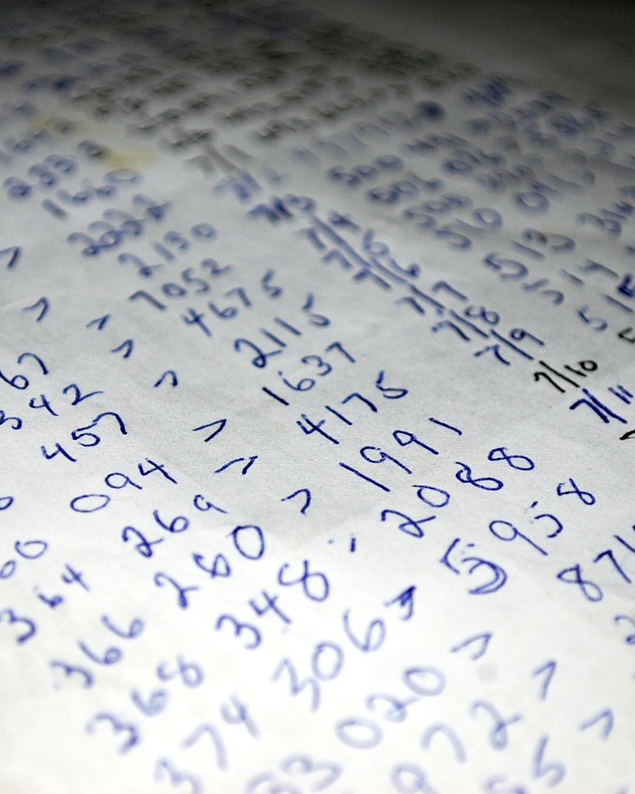
Variability
How the meaning of the data changes over time
Language evolution
Data availability
Sampling processes
Changes in characteristics of the data source

Slide 13
Viscosity & Volatility
Both related to velocity
Viscosity: data velocity relative to timescale of event being studied
Volatility: rate of data loss and stable lifetime of data
(Scientific data often has practically unlimited lifespan, but social / business data may evaporate in finite time)

Slide 14
More V’s
Viability
Another take on value. Which data has meaningful relations to questions of interest?
Venue
Where does the data live and how do you get it?
Vocabulary
Metadata describing structure, content, & provenance
Schemas, semantics, ontologies, taxonomies, vocabularies
Vagueness
Confusion about what “Big Data” means

Slide 15
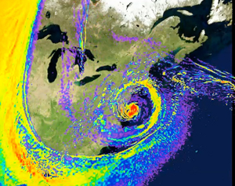
Big Data in Climate Science
Models: Big Volume
Observations: Big Variety
The Future: Data Services

Slide 16
Dealing with Volume
Distill big data down to small information
Parallel and automated analysis
Automation requires standardization
Standardize by reducing Variety:
Format
Standards
Structure

Slide 17
Data Formatting
NetCDF:
Self-describing
Machine-independent
Integrated metadata
Geo-data oriented data model
Archive Specs:
1 variable per file
Filename conventions
Metadata requirements
Standard set of outputs

Slide 18

Data Standards
Community-governed
Extensive and detailed
Resolves many representation questions
Rules governing file element naming conventions and metadata contents for NetCDF
Controlled vocabulary for semantic attributes (physical quantity, canonical units)

Slide 19
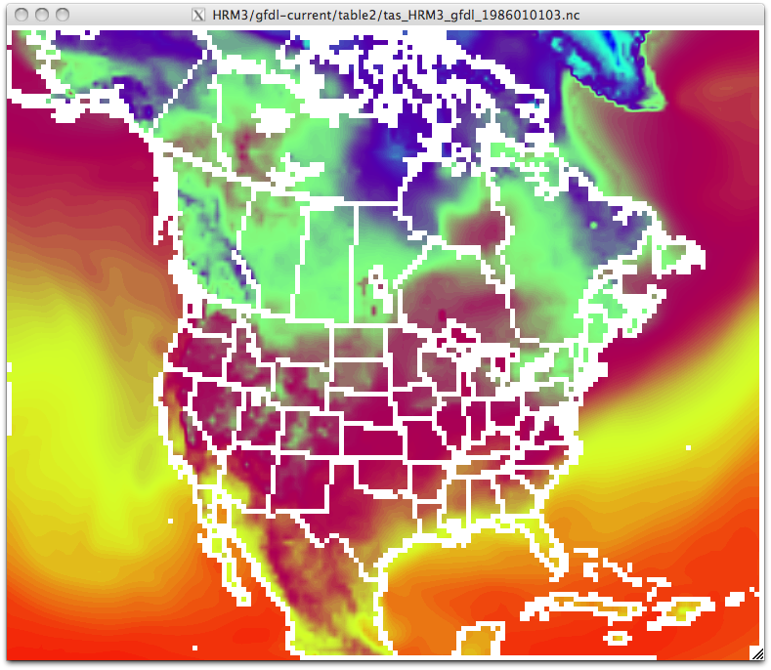
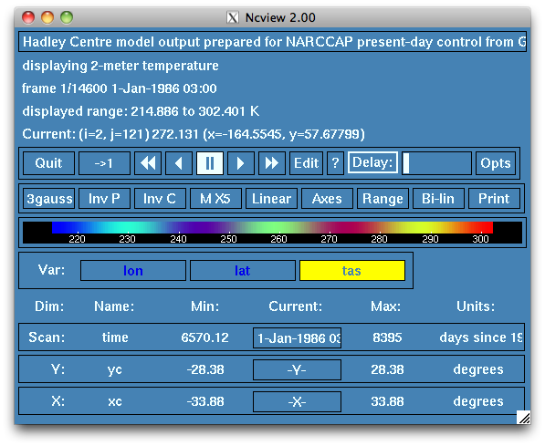
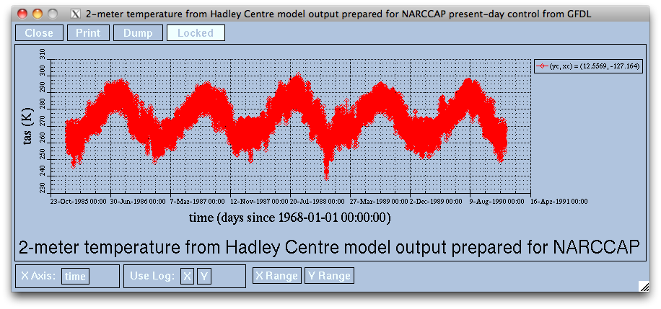
NetCDF + CF enables smart tools

Slide 20
Data Structure
Fields (synoptic) vs rods (timeseries)
Data generation vs data usage
Transposition needs ALL THE DATA
Expensive in either memory or time
Big task if you do it all at once at the end
Less so if you amortize across data generation
Intermediate: granules / chunking / tiling
Small granules vs dual representation
Logical organization vs physical organization
Figure out what best suits your users

Slide 21
Archiving Lessons Learned
Automate everything you can
Be stringent about specs & standards
Minimize splitting; maximize segregation
Version your data & plan for iteration
Structure data to suit end uses
Prioritize based on end value
Filenames are not metadata

Slide 22
Dealing with Irreducible Variety: Maximize Discoverability
Use a short “discovery metadata” profile common to EVERYTHING in the archive
Then: Dublin Core
Now: ISO-19115
Doesn’t need to be comprehensive; 80% coverage nets big improvement
Controlled vocabulary for semantics
Well-documented profile is important

Slide 23
Documentation Is Hard
General Strategies
Data producers know the information but don’t need it
Data consumers need the information but don’t know it
Incentives?
Unsolved problem
Have to meet data producers’ needs
Data curation
Agile
Humans still beat machines
Be a middleman in the data supply chain

Slide 24
The Future: Data Services
Analyze and transform data before transfer to end user
Network $ > Disk $ > CPU $
∴ Server-side computation makes sense
Reduce the need for large data downloads
Capture expertise as automated processing
Improve usability for applications & non-specialists

Slide 25
The Capstone System
Draft Architecture
Web-based server-side data analysis
Modular community-governed toolbox architecture
Chained data services
Workflow persistence
Share, cite, discuss, etc.
Proposal submitted to DIBBs
APPLICATION
Web UI
Workflow Web App
Workflow Repository
APP SERVICES
Discovery, Persistence
Microservice Catalog
NCO, OCGIS, Xarray
MICROSERVICES
RESTful APIs
Scheduler
Cache
PROCESSING
Resource Management
Thredds
CATALOG
Data Access Inventory
OPeNDAP
TDS
BASE SERVICES Data Access
CMIP
CORE.II
Obs
DATA ARCHIVES NetCDF on Glade
CORDEX
NARCCAP

Slide 26

Questions?

